Slide 1

Agile v. Waterfall Software Development
Mark Witt
CSD205-345A

Slide 2



Agenda
What is the Waterfall methodology?
What is the Agile methodology?
What are the benefits of each?
What are the limitations of each?

Slide 3

What is the Waterfall methodology?
Waterfall methodology is the traditional linear method of the software life cycle
Each step must be complete before moving onto the next, i.e., flowcharting and overviews done before coding
A broader, step by step approach to the entire project.

Slide 4
Waterfall Method of the Software Development Life Cycle
Requirements
Identify requirements and needs of the customer
Analysis
Collate all information and requirements into what will be needed for the project
Design
High level overviews of the project, including flowcharting and pseudo coding
Implementation
Testing
Making sure the newly created software functions as intended. Debugging and troubleshooting occur during this phase
Taking the designs and writing the software in code
Deployment
Deploying the final product, usually the sale of the software or the deployment of the new software across an organization.
Maintenance
Includes any debugging, troubleshooting and adjustments after installation

Slide 5

What is the Agile methodology?
Agile methodology breaks each part of the project down into smaller chunks, often called the project backlog
Project timelines broken down into Sprints
The project does not have to be completed all at once, and can be done in a more flexible non-linear fashion
Multiple sprints can be done by different teams at the same time.

Slide 6
Agile Methodology Life Cycle
Product Backlog
Sprint
Meetings
List of product requirements that take the form of a story.
Prioritized in descending order
Each story can be broken down further if needed
Each story is a compartment of the project, and serves its own function for the final product
Specific timeframe for teams to complete each story
Multiple teams can work on different sprints/stories of the same product at the same time
Usually each sprint/story can function on its own, without the rest of the project
Once all stories and sprints are complete, the entire project can be compiled together
Teams hold short, 15-minute meetings each day to review progress and make adjustments to the project if needed
Meetings will also review Product Backlog and ensure timely delivery of final product

Slide 7

Benefits of each methodology
Waterfall
Agile
Sequential design process
Separated into distinct phases
Software completed as one project
Easy to manage
Process of the project is very well documented
Client focused, client is involved in each stage
Quality is maintained at each stage
Flexible, easy to adapt to change in project requirements
Testing is done throughout the process

Slide 8
Limitations of each methodology
Waterfall
Agile
Requires clear, unchanging requirements
Rigid structure
Each phase must be complete before moving onto the next
Testing does not start until entire project comes together
Not ideal for larger projects
Requires expert leadership for decision making at each step
Project can get off track much easier without constant attention from project manager
Not ideal for smaller projects

Slide 9
Things to Consider when choosing a method:
Does the project require flexibility?
How big is the project?
Can/Will requirements change during the project

Slide 10

Customers don’t measure you on how hard you tried, they measure you on what you delivered.
Steve Jobs,
Co-Founder of Apple

Slide 11
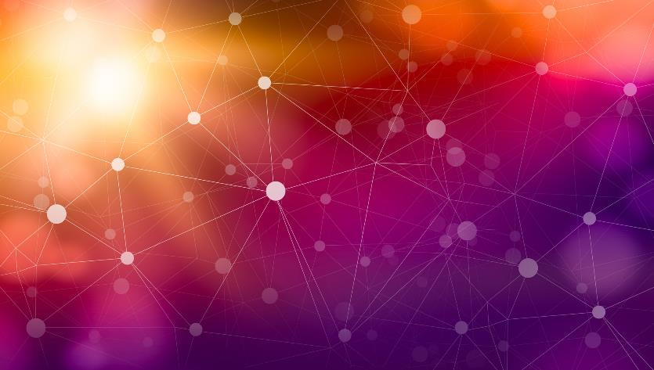

Thank You
Mark Witt

